Slide 1
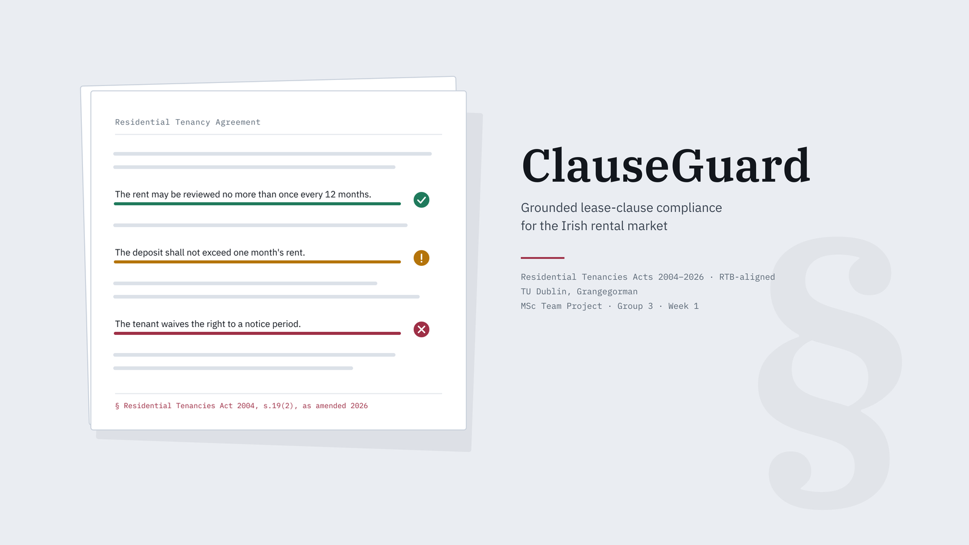
ClauseGuard
Updates
A private rental specific deterministic point-in-time compliance engine and shared tenancy ledger. Keeping landlords, tenants and agents completely up-to-date on RTB rules.

Slide 2
ClauseGuard: Backened Engineering
New users can create an account and log in
after implementing Firebase Authentication by email/password login
(Google sign in supported too)
Passwords are entirely handled by firebase, which is hashed and never stored in our database
To manage session handling, firebase id tokens (JWT) will be used. These will be verified on each request to check if the user is logged previously or not which helps users to stay logged in
Using firebase UID, we will fetch profile data using PostgreSQL for user to update it
CORS and access-control settings on the backend
using Firebase Admin (SDK verifies tokens; rate limiting, HTTPS via Caddy)
Signup and Login
Password Security
Session Handling
Account Management
API Security
Main goal of this sprint is to develop a working login system services of sign up, log in, and profile updations
Agenda point 3
Agenda point 2

Slide 3
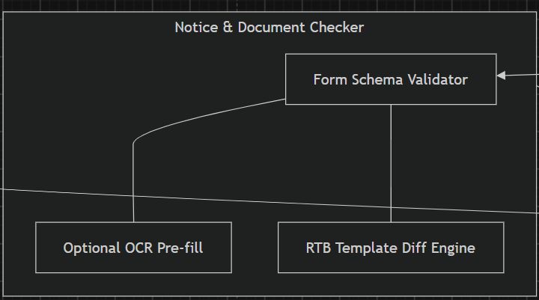
ClauseGuard
Document Checker Developer
  This week, the schema validators were looked into for capturing important or critical dates within lease agreements or termination notices.
  Working on an RTB Template Diff Engine that needs to be compared with the official baseline.
  Working on the redaction of PII data when document being scanned by OCR.
  Need to work on connecting the ingestion pipeline to the API to automatically run the rule engine.
  Need to implement the OCR for successful text extraction.

Slide 4
ClauseGuard
ClauseGuard: from lease pdf to cited verdict
Parse the lease PDF, OCR scans, split into clauses (yeah, kind of in that order)
Fine-tuned Legal-BERT assigns each clause a category
like “liability” or “termination”
Rules engine for numeric tests, retrieval for interpretive clauses, sort of “read this like a human”
Check citations and say “needs review” when unsure, because sometimes the source isn’t clear
1
Extract
2
Classify
3
Decide
4
Verify
Pretrained models for retrieval, one fine-tuned classifier, and the rules engine makes every legal decision.
Agenda point 3

Slide 5
ClauseGuard
What we use and what we train
Embeddings and reranker
Pretrained sentence-transformers models, tested on our clause-to-law pairs
Clause classifier
Legal-BERT (contracts variant) fine-tuned on our labelled clauses
Rules engine
OpenFisca with dated statutory rules makes every compliance decision
Abstention
Conformal calibration on a held-out set flags "needs review"

Slide 6
ClauseGuard
Data, labelling and evaluation
What we label
How we label
How we judge
  Clause boundaries
  Category and extracted values
  Verdict: compliant, non-compliant or needs review
  Supporting Act section
  Written guide, using the law in force on the tenancy start date
  Pilot round, then agreement check
  Second annotator and adjudication
  Test set frozen, split by lease
  Per-class F1 with bootstrapped confidence intervals
  False-green rate: violations marked compliant
  Citation validity and faithfulness
  Four systems compared on the same test set

Slide 7
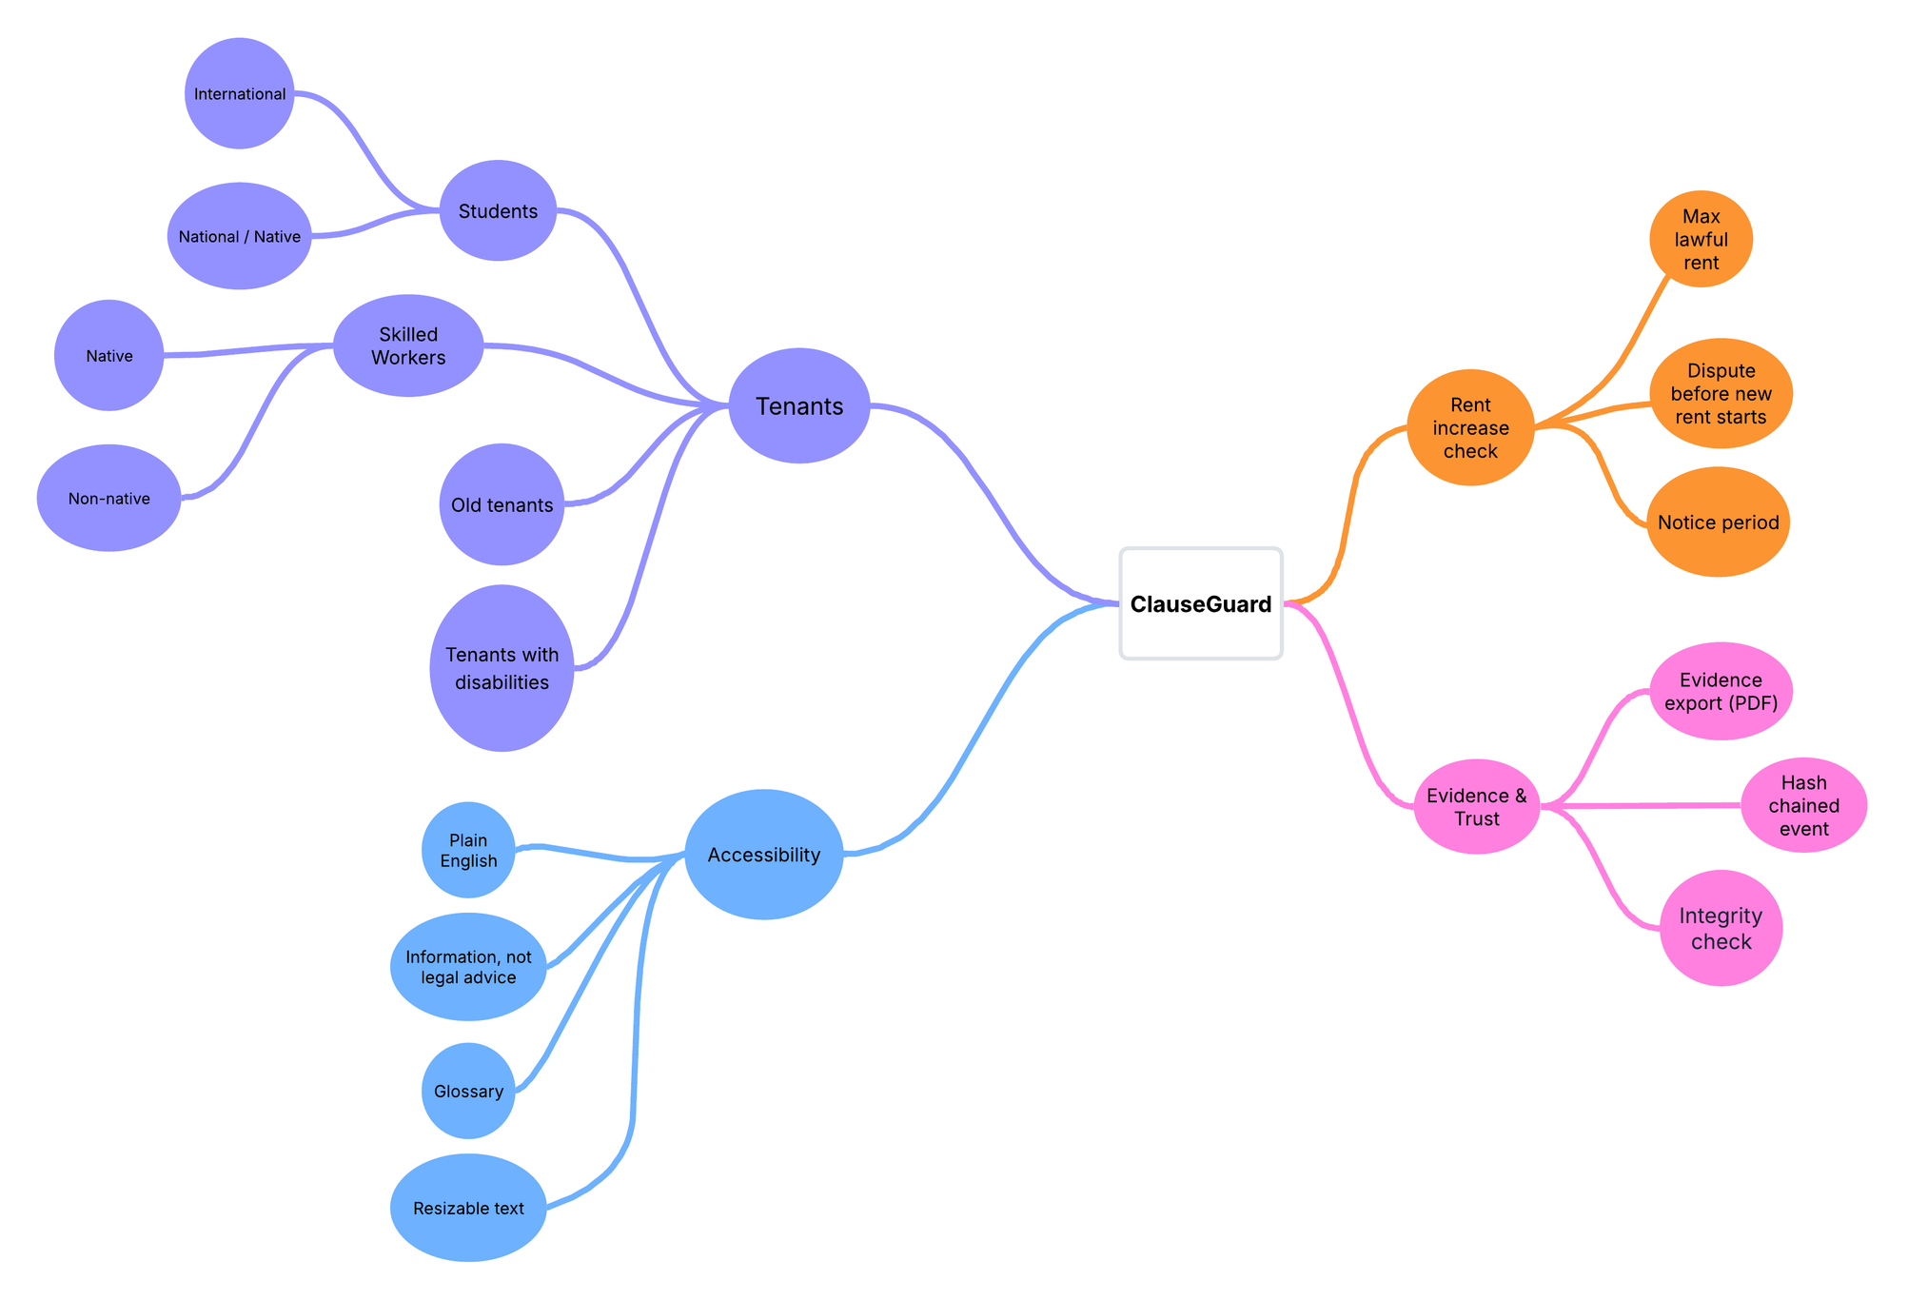
Mind Map

Slide 8
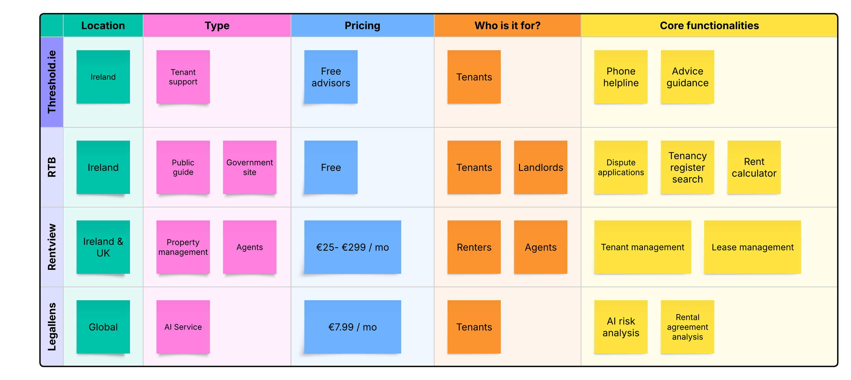
Competitor Analysis

Slide 9
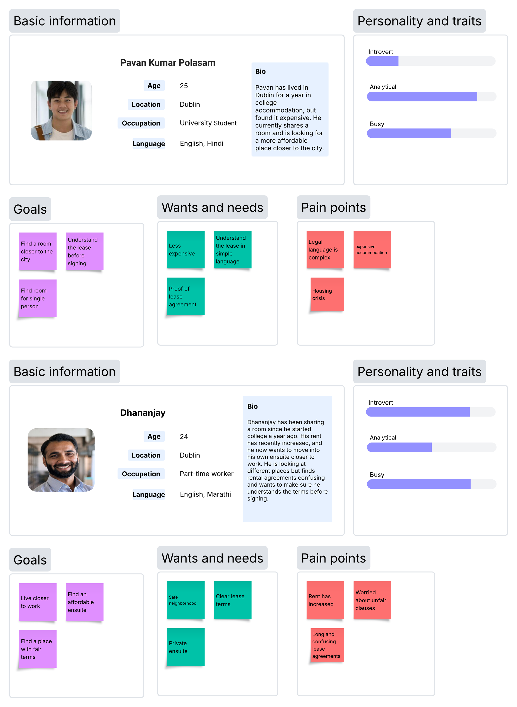
Persona 1

Slide 10
Persona 2

Slide 11
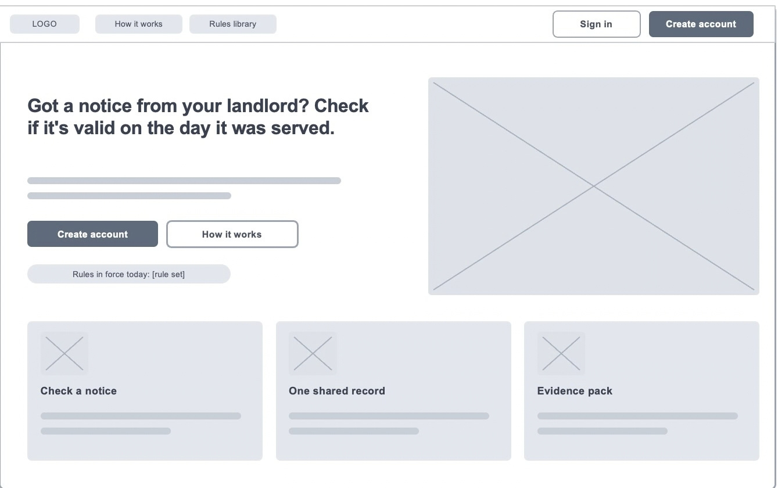
Wireframe

Slide 12
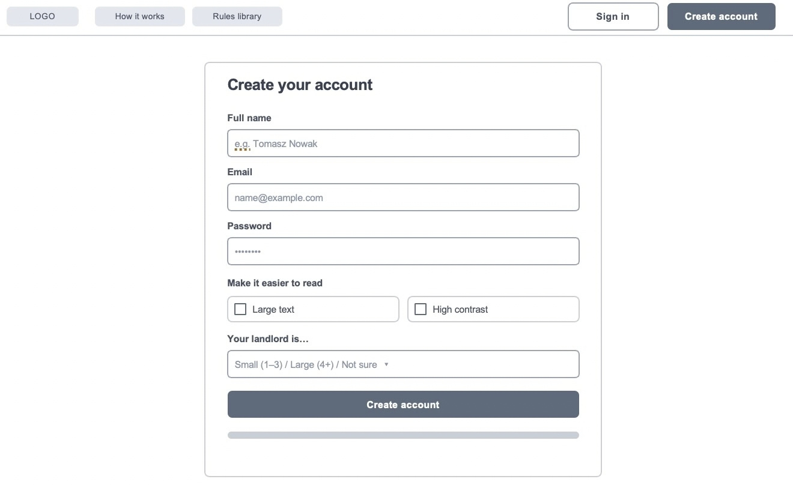
Wireframe

Slide 13
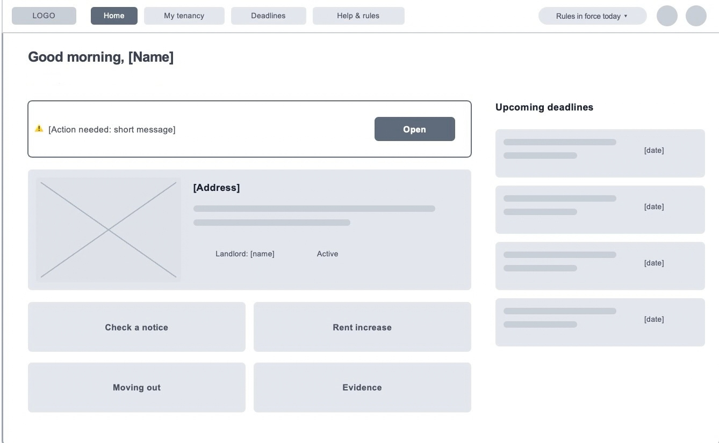
Wireframe

Slide 14
ClauseGuard
Next Week Tasks
  Complete the SQL TenancyEvent schema and make the initial migrations.
  Use Tesseract to extract text blocks and extract the "Service Date" and "Proposed Termination Date" field values.
  Take the dates from the OCR and arrange them in a standardized JSON schema which the Rules Engine can consume.
  Implement controls and sequence-number validations to ensure event writes are not conflicted with one other.
  Have to have a working demo so that we can test the integrations.

